Slide 1


Data visualization project
Mohamed Khaled Mohamed 20191474372
Mina Ibrahim Sophy 20191474668
Mena Allah Ashraf Mahmoud 20191474929
Esraa elsayed Mostafa 20191475187
Sara Mohamed Mohamed Ibrahim 20191616622

Slide 2
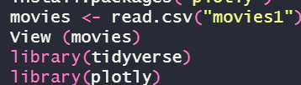
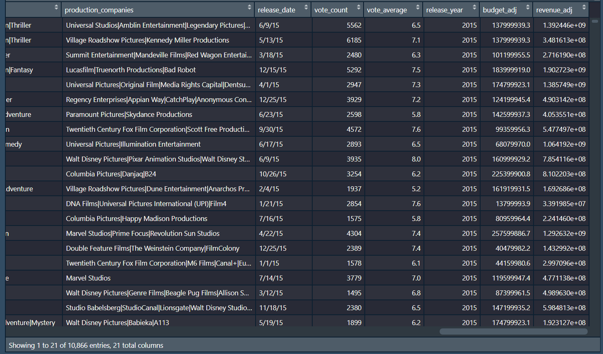

Slide 3

In this analysis we are looking for unexpected case or visual for our data we all know that it’s normal when you pay more revenue the better the movie will be and the more it will gain revenue, it’s expected, so far, we are looking in this report for unexpected relation make our data more obvious

Slide 4



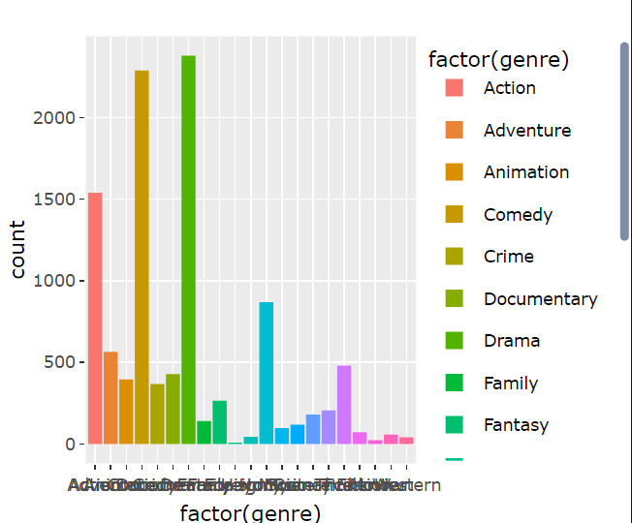
Geners of movies

Slide 5
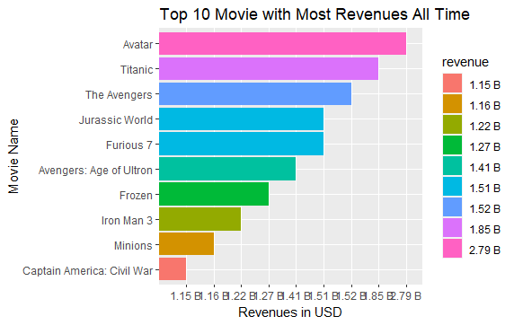
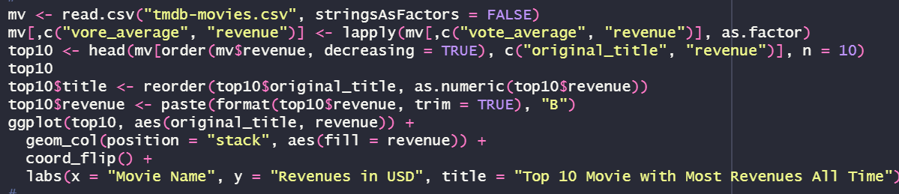
This is a simple sorting for movies depending on its revenue

Slide 6
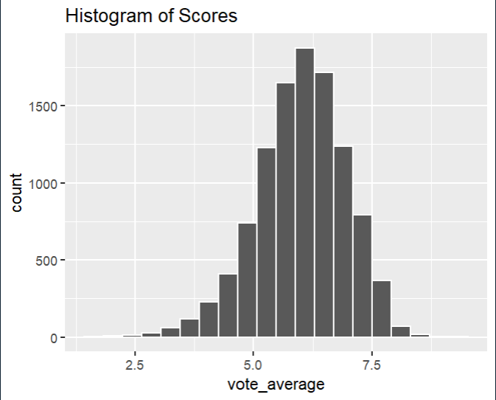
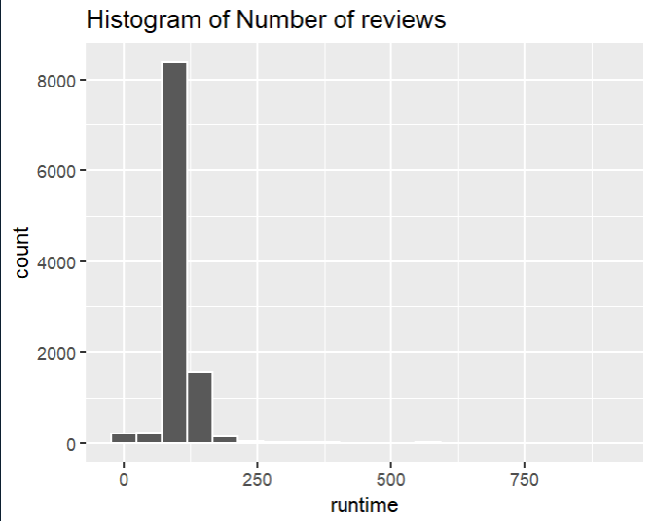
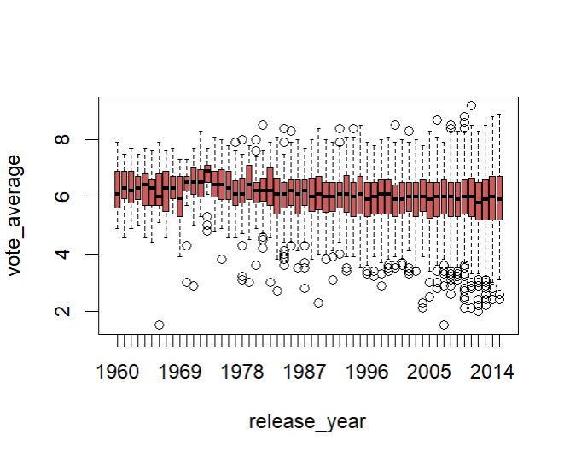
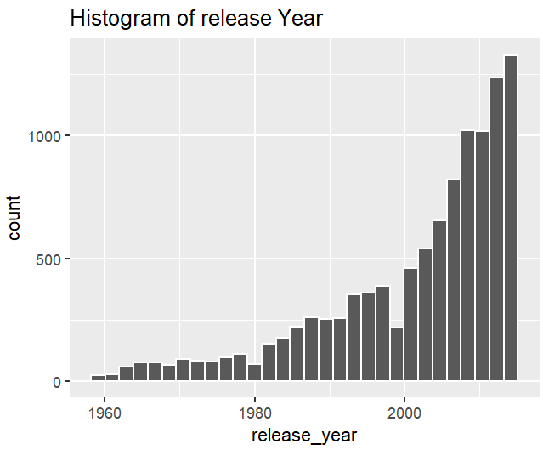
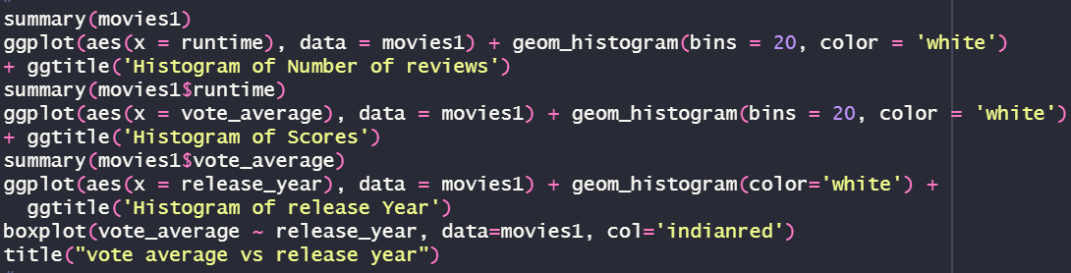
Geners of movies
Most of movies have rate for 4:6 all over years

Slide 7
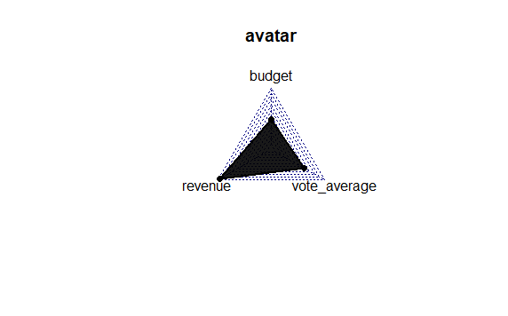
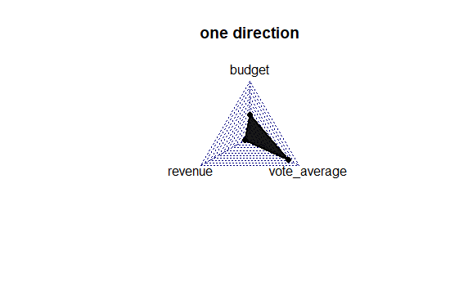
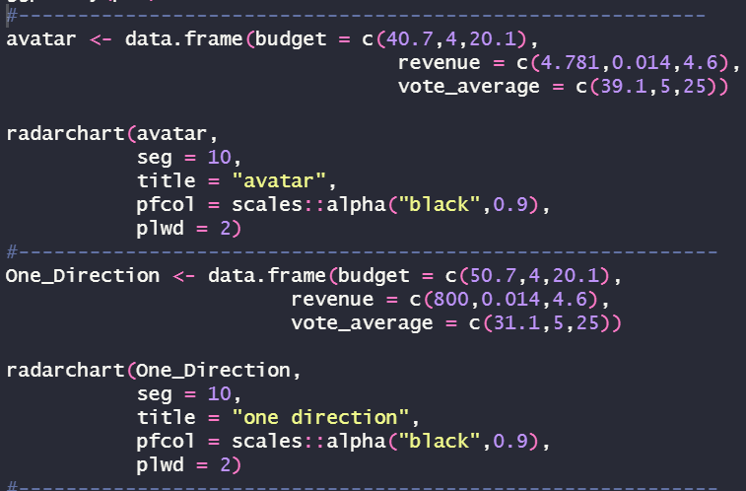
But a movie like one direction payed mormal budget and got so low revenue and got the highest vote_average which commit our analysis that budget is near to revenue whatever it’s lower or higher and vote_average is independent from both
Random samples
we can see here a movie like avatar pays not that much on budget and get the highest revenue which reflected on its rate

Slide 8

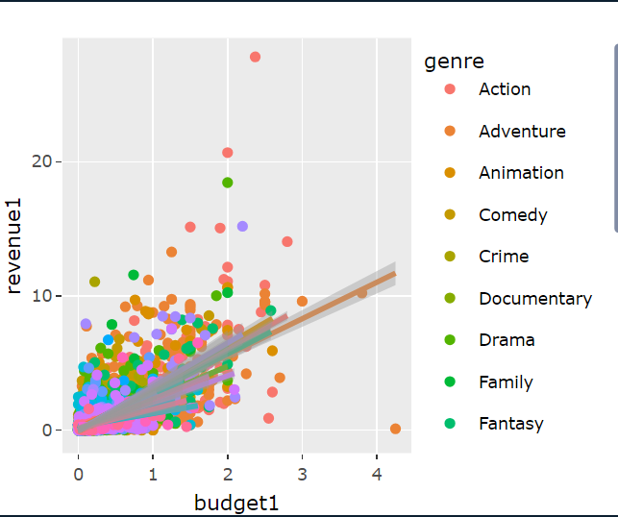
Budget & revenue Relationship
There is a direct relationship (increasing) between the budget and revenue. When adding the vote_average to this relationship, it has been observed that most revenue comes with the most budget.

Slide 9

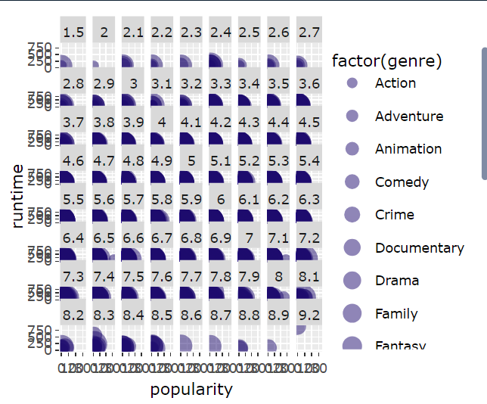
MAPPING THE DATA
As we see here, when vote average increase independently each sector increases too and runtime also make it widder

Slide 10

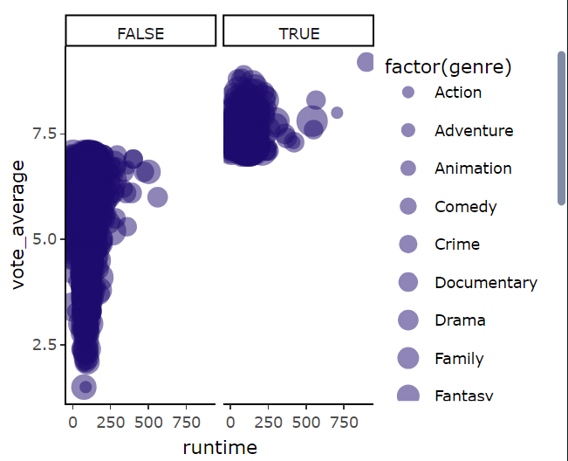
Making Vote_average with runtime relation more clear
To make more obvious we make we limited it to see what runtime exactly do with vote average as we see here low runtime can be with a bad vote average and with a good vote average, but the highest runtime is always having the best vote average

Slide 11

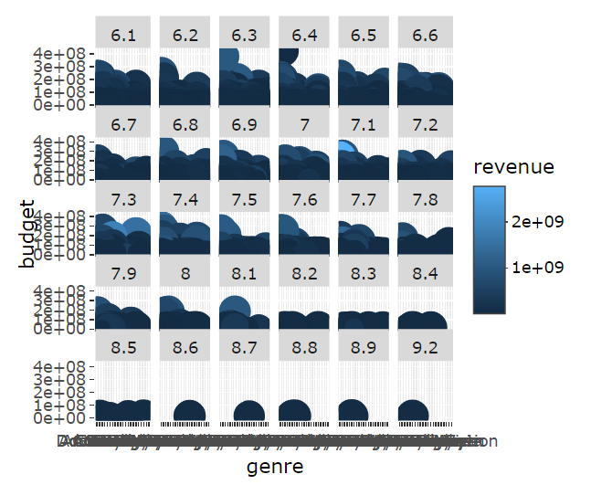
ANOTHER KIND OF MAPPING THE DATA
In this picture we want to know the relation between budget and revenue but under wrapping the vote average which is bigger than 6 and the genre as a factor and we find that when we gets more runtime the less we get revenue and we here realize that revenue is independent for
(runtime + vote average) as we can see most runtime + medium rate like 7.5 give me the highest revenue

Slide 12
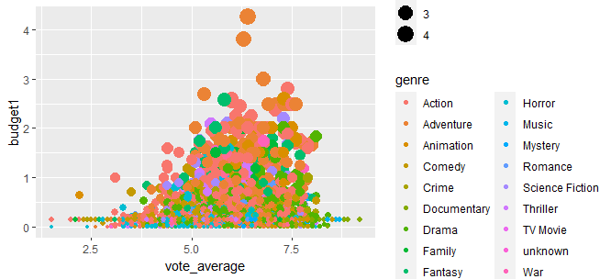
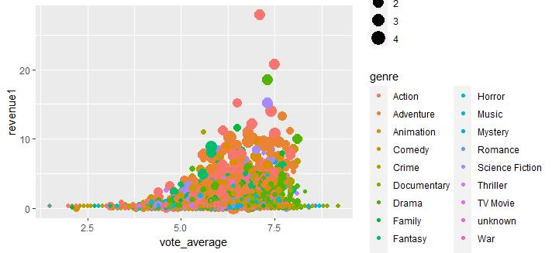
From this plots we realize that most movies costs budget is (action) and it gain the most revenue too

Slide 13
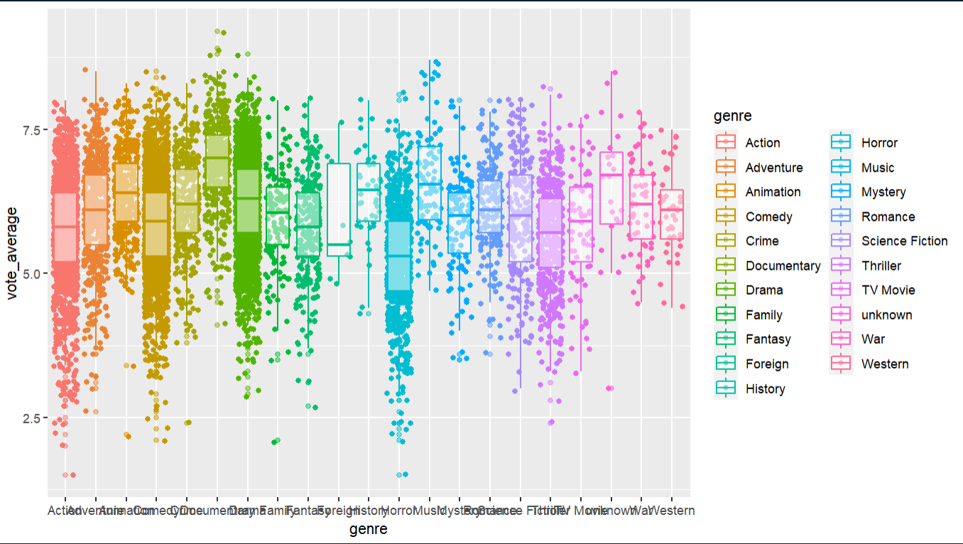
Vote average with revenue relation with factor genre
Here we realize that the most average counting is action movies but the highest average is for drama movies

Slide 14
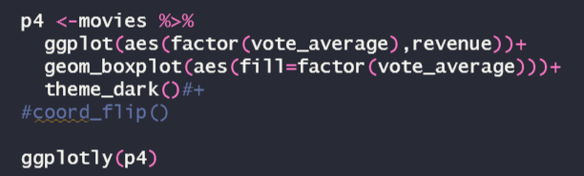
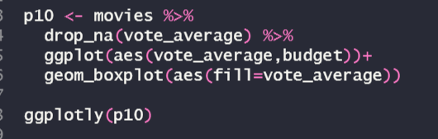
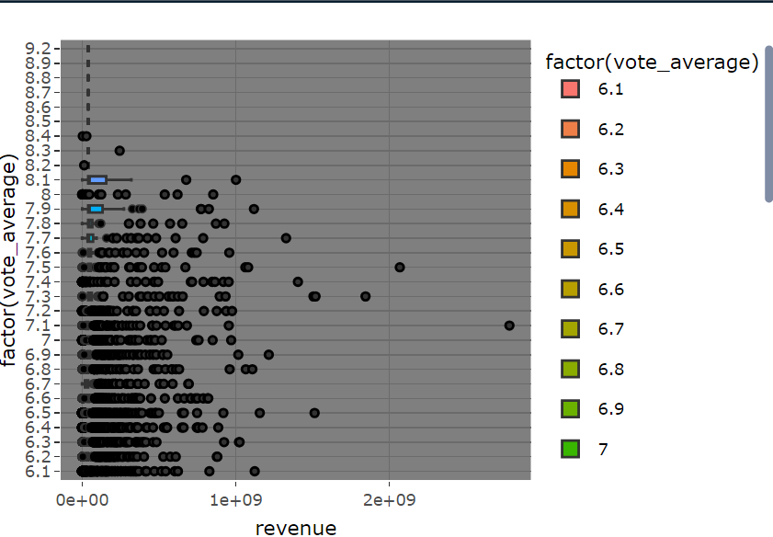
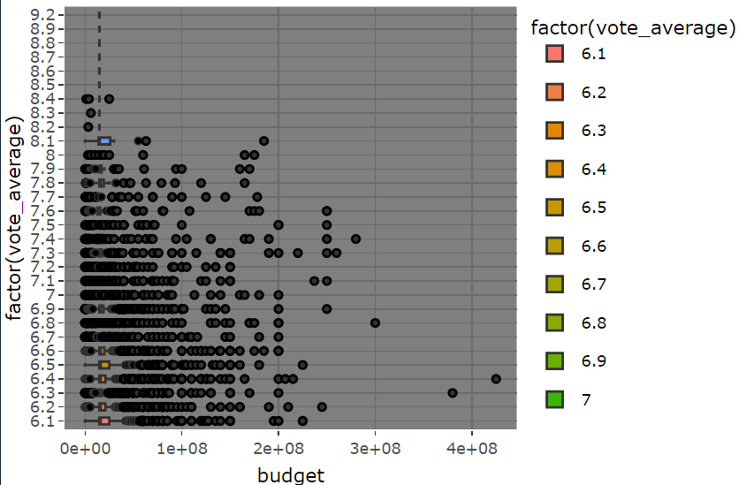
This simple boxplot shows the relation between vote average and revenue we realized that not the most vote_average sector get the most revenue and this is normally like we see here one of (7.2) got the most revenue and
This simple boxplot shows the relation between vote average and budget, and we realize that sometimes they pay a lot of budget and get low average and sometimes they pay for the movie few budget and get the highest average so the rate here is inverse relation between them

Slide 15
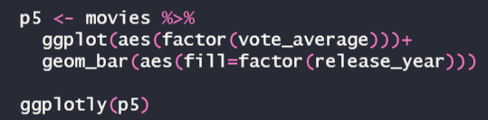
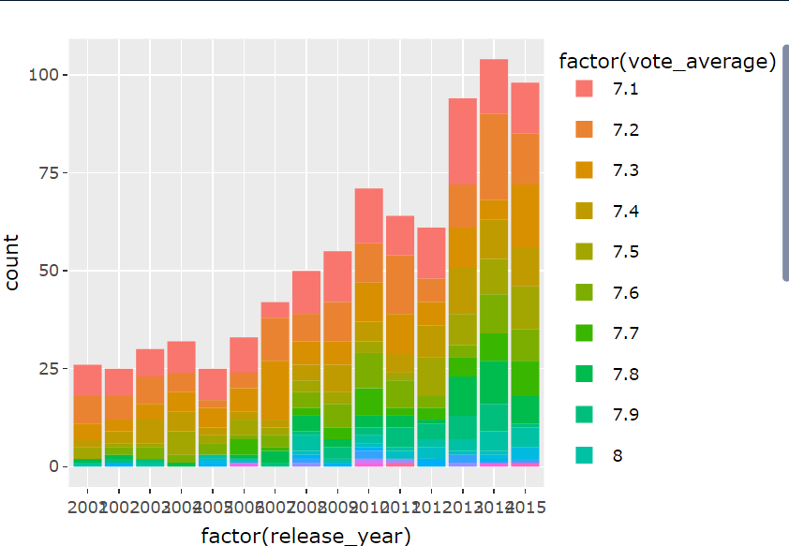
Release year and movie rate
here we see the relation between vote average and release year
And we realize here that least rates is from 2001 to 2017 and rarely to find some movies and every year has all rates’ movies but after 2010 is the highest rates ever but in total view we get that with increasing the year the number of the movies increases and the vote rate is also increasing

Slide 16

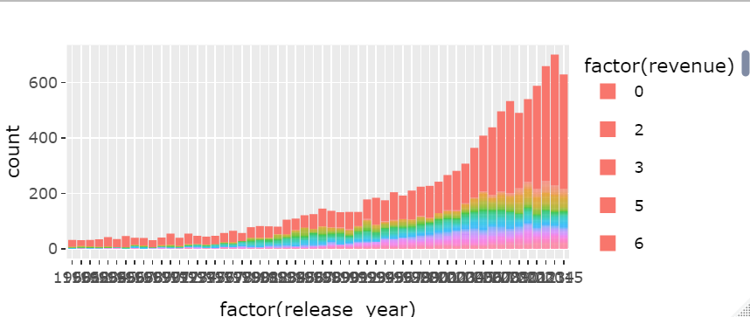
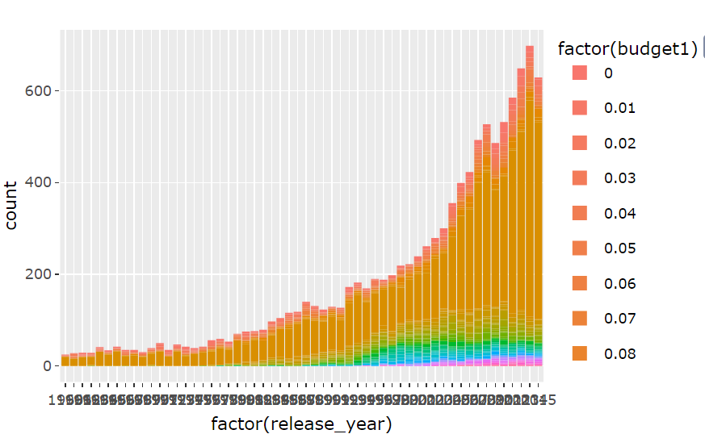
Release year and (revenue,budget)
As we can see here the newer years have more burden with highest revenue

Slide 17

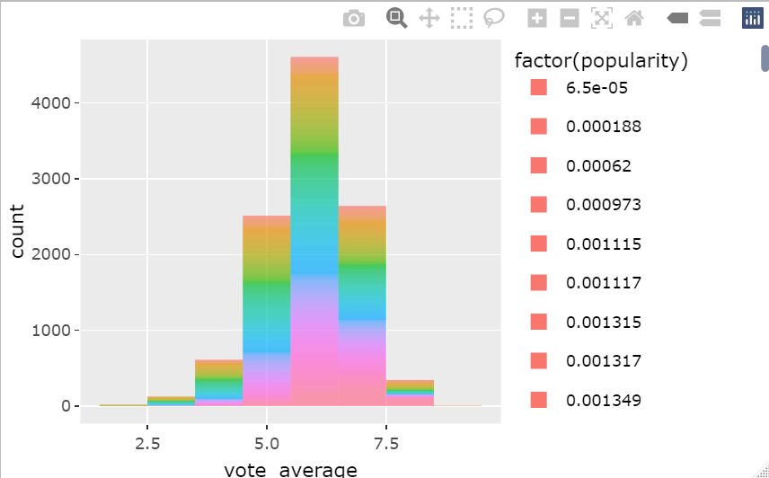
Vote_average and popularity relationship
This histogram shows that the most popular movies gets the highest vote rates and it’s normally to find the midum sector got a lot of popularity too

Slide 18
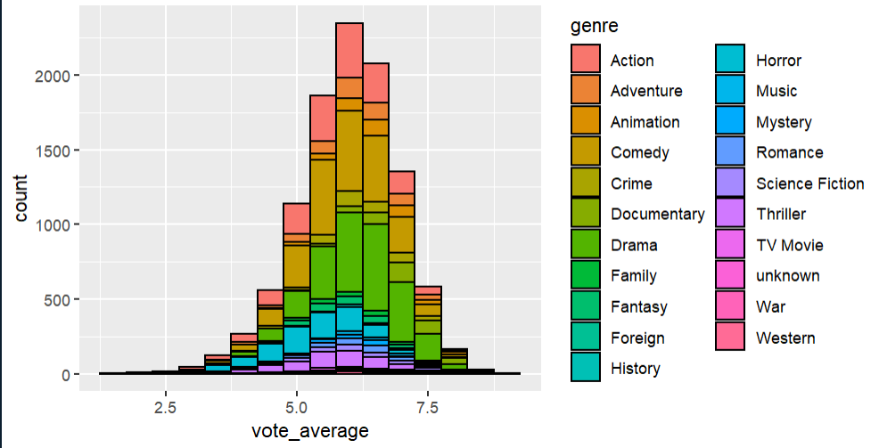
Vote_average and genre relationship
Here we realize that most rated movies are drama, animation documentary and comedy

Slide 19
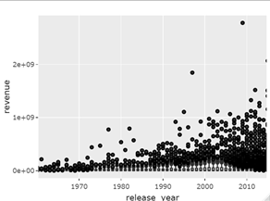
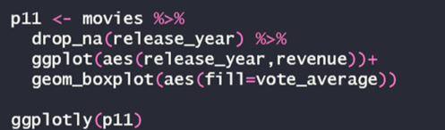
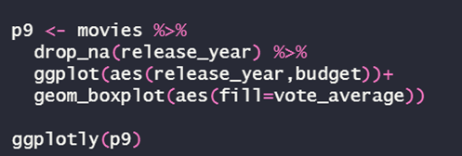
here we see that the newest the movie is the more they make it with budget and the more they get from it revenue

Slide 20
Scaling and manipulating with data

Slide 21
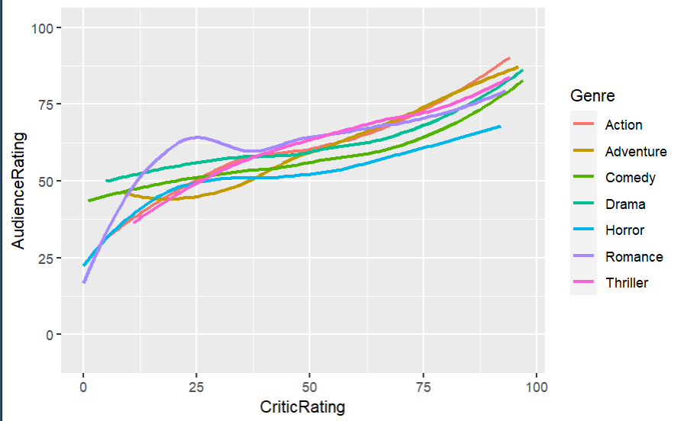
Audience rating and critic rating relation
Here we want to know if there a relation between audience and critic rating, actually we realize that almostly they are neat to each other

Slide 22
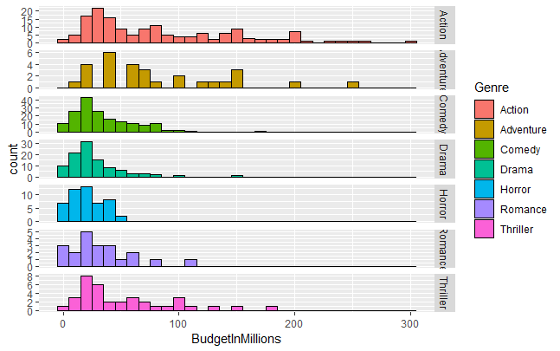
Budget an dgenre realtion
And here we realize that movies which costs most budget are action movies

Slide 23
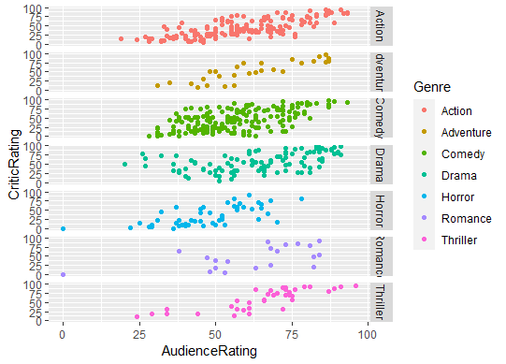
Audience rating and critic rating relation for genres
And here we find out that movies which have most rating whether it’s bad or good rating are comedy movies

Slide 24
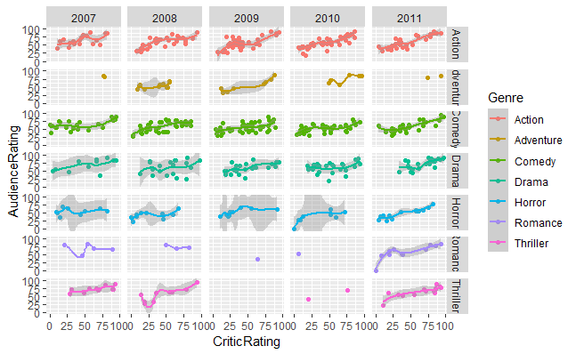
Audience rating and critic rating relation for genres over random years
We realize that action movies are stand still
And adventure movies increases
Comedy are still the same
And horror too are still the same
Romance increase and thriller too increase

